Slide 1
Mining NIH Grant Data

Slide 2
Data Sources
~2.2 million NIH grants
~30 years (1985-present)
~253 thousand PIs
~118 thousand terms
~57 million grant-term relations

Slide 3
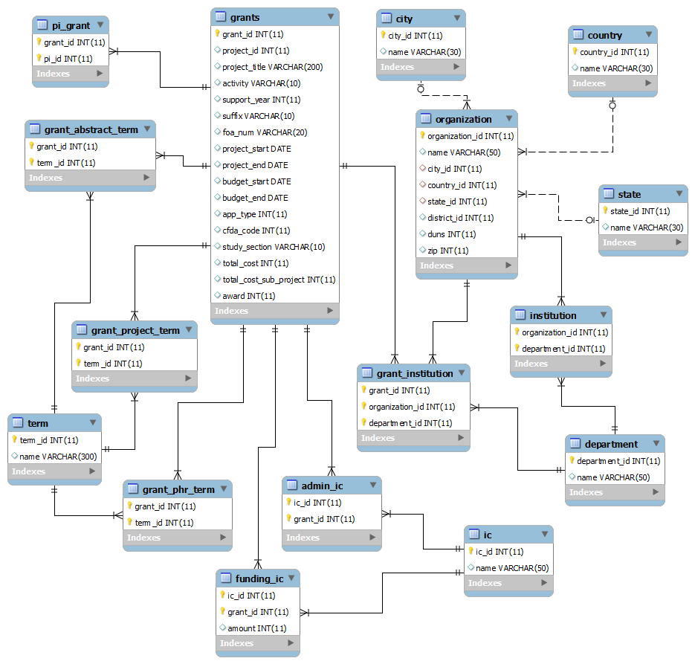

Slide 4
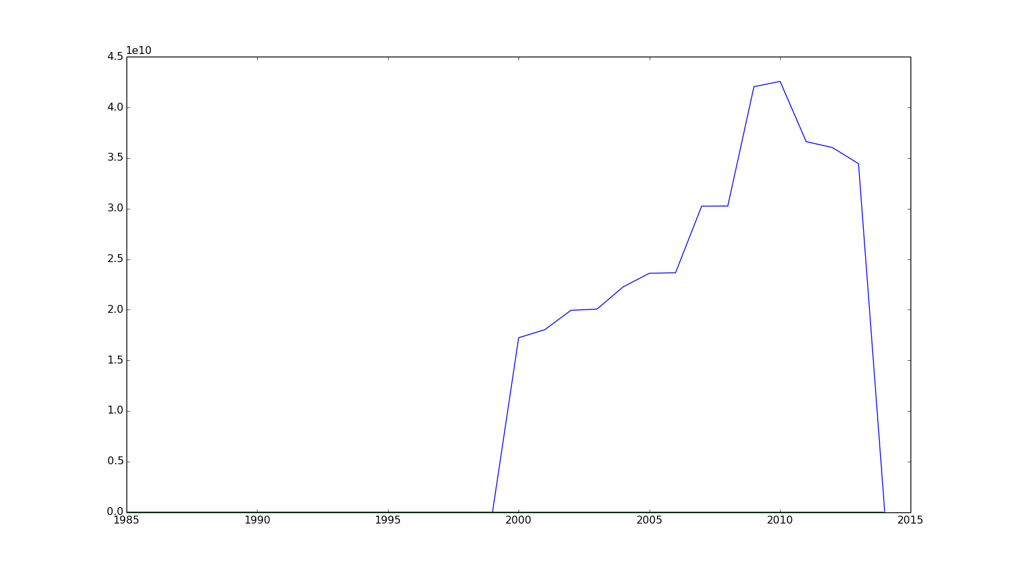
General Statistics: Grants per Year

Slide 5
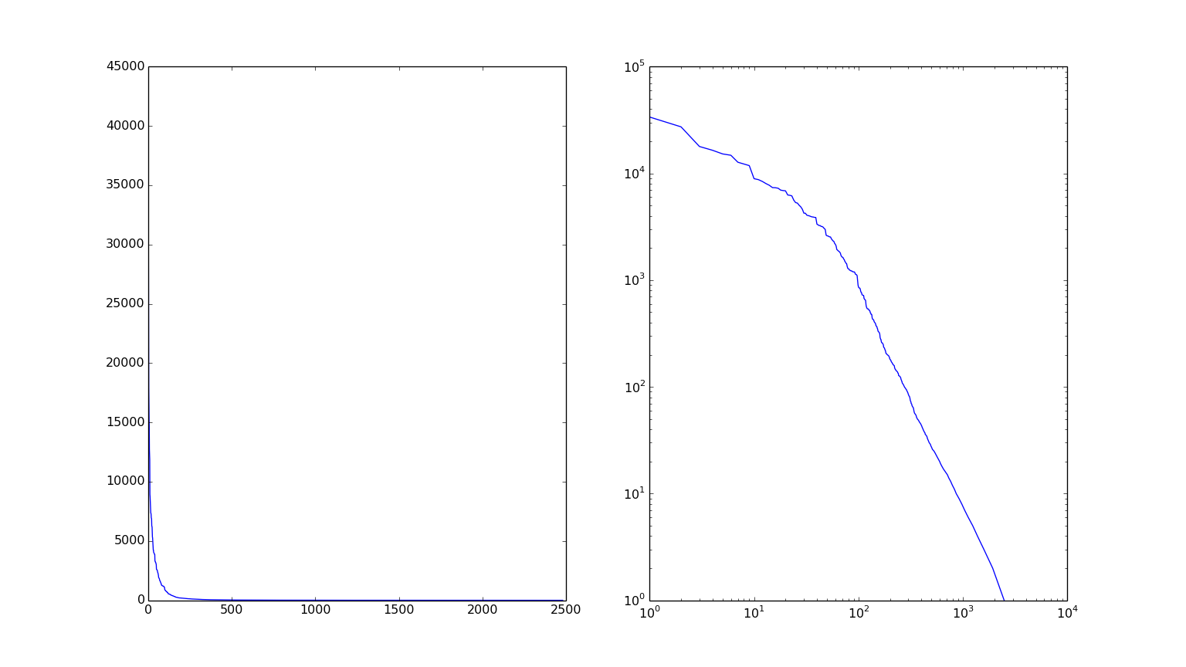
General Statistics: Grants per City

Slide 6
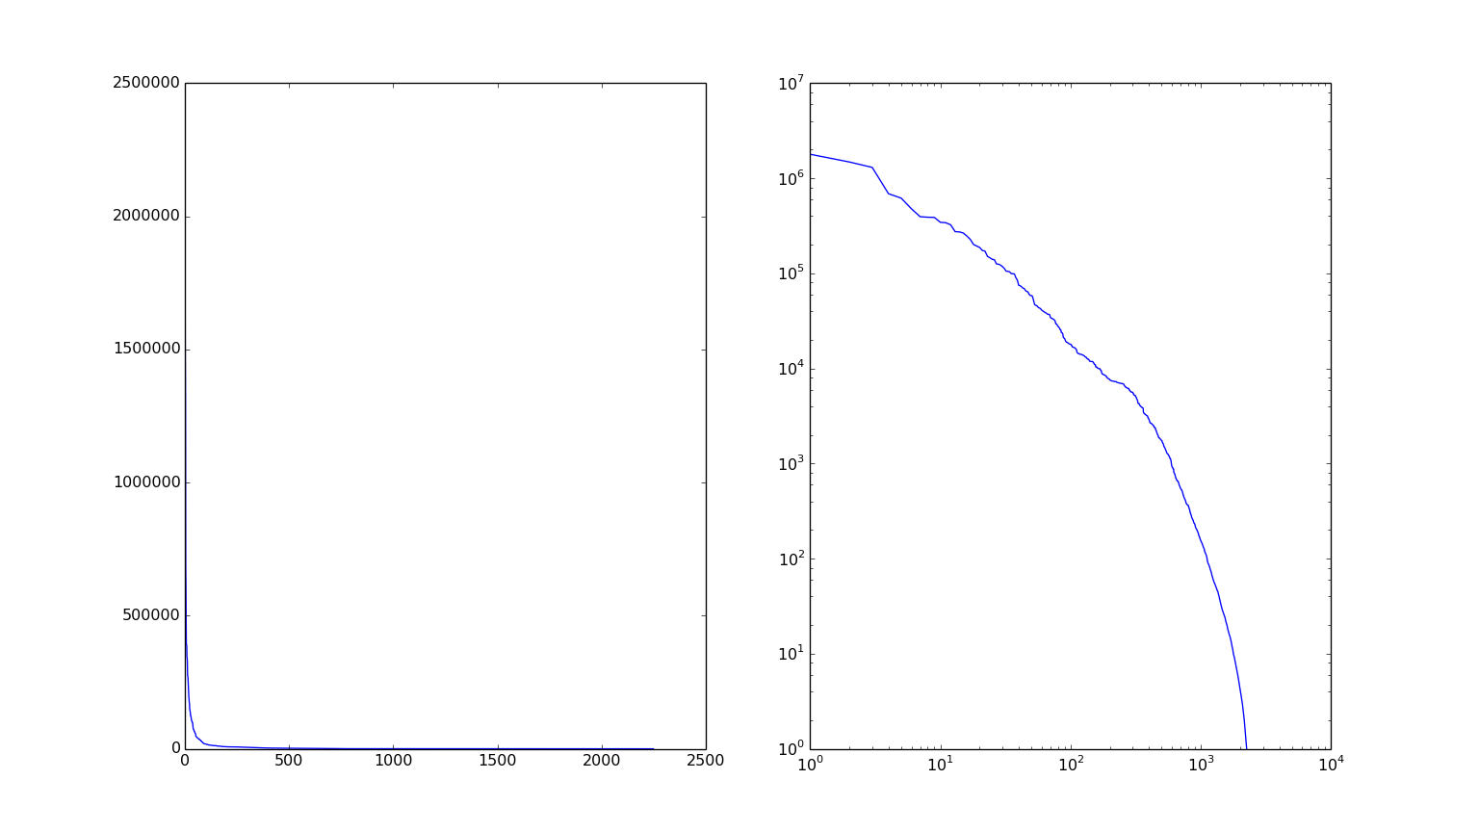
General Statistics: Grants per County

Slide 7
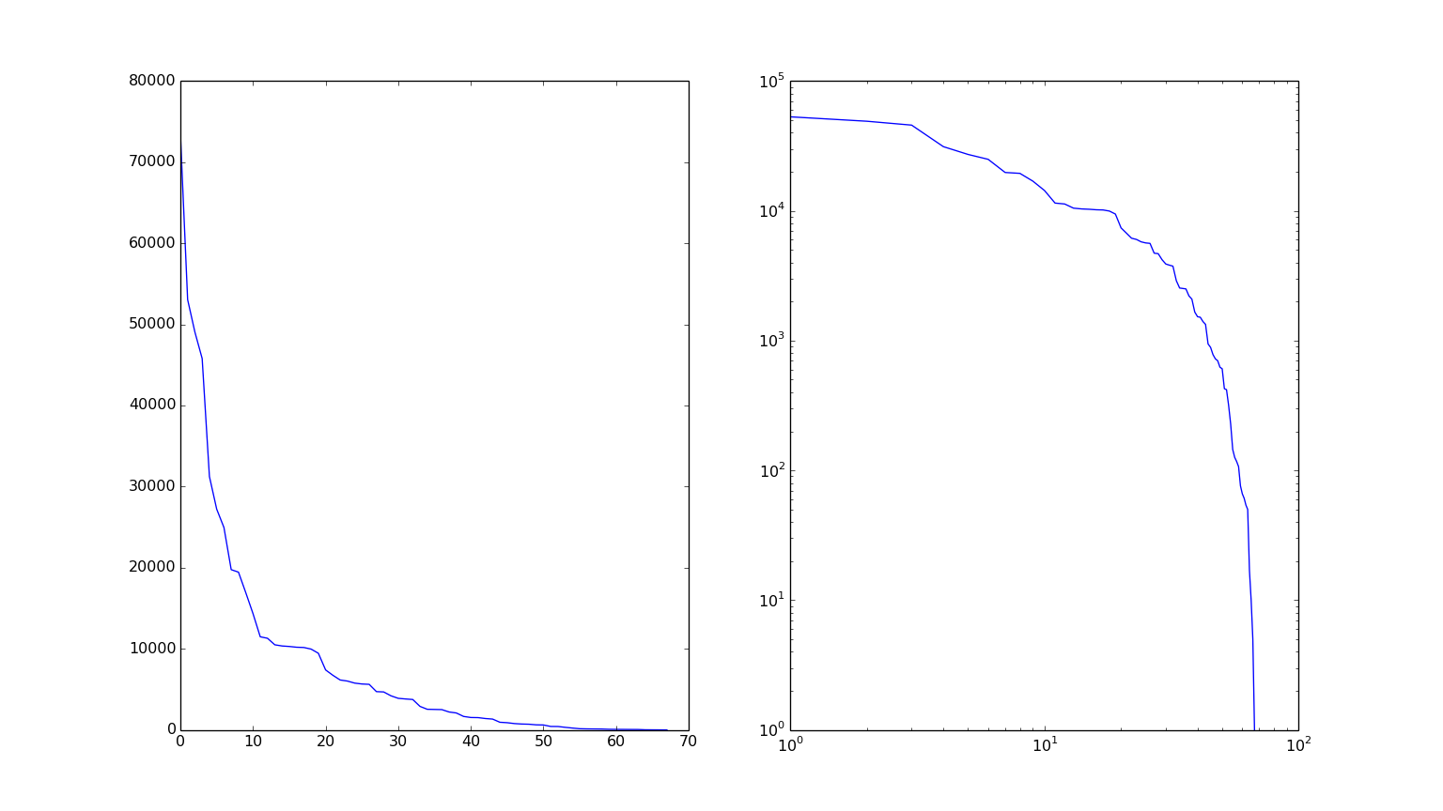
General Statistics: Grants per State

Slide 8
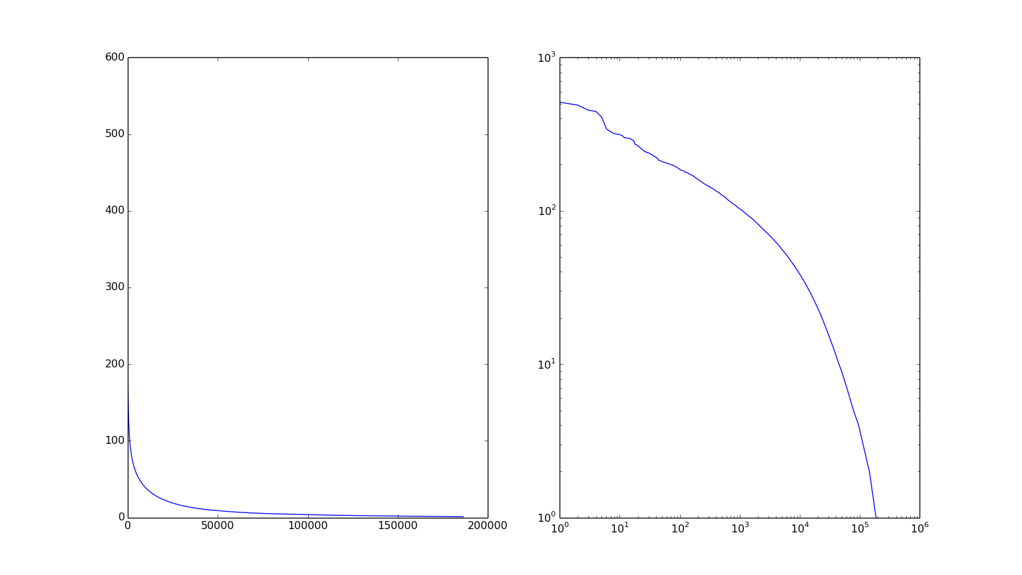
General Statistics: Grants per PI

Slide 9
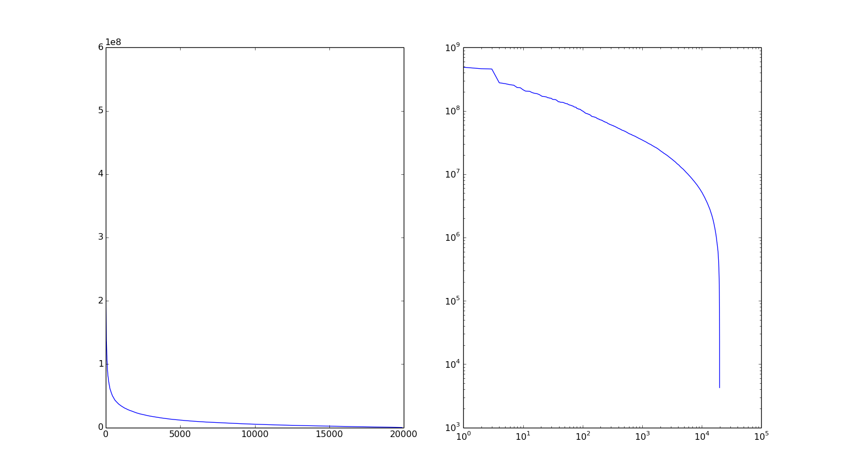
General Statistics: Funding per PI

Slide 10
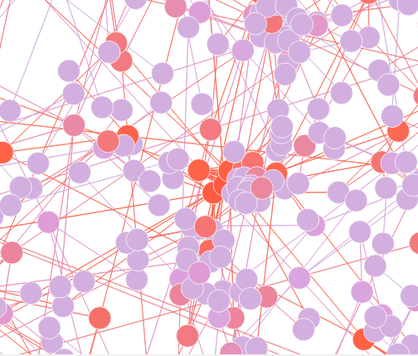
Co-PI Network Analysis
Closeness
Betweeness
Network Constraint
Clustering Coefficient
PageRank

Slide 11
Data Visualization
Co-PI Network
US Heat Map

Slide 12
Grant Clustering
50th of dataset
Equal distribution of years

Slide 13
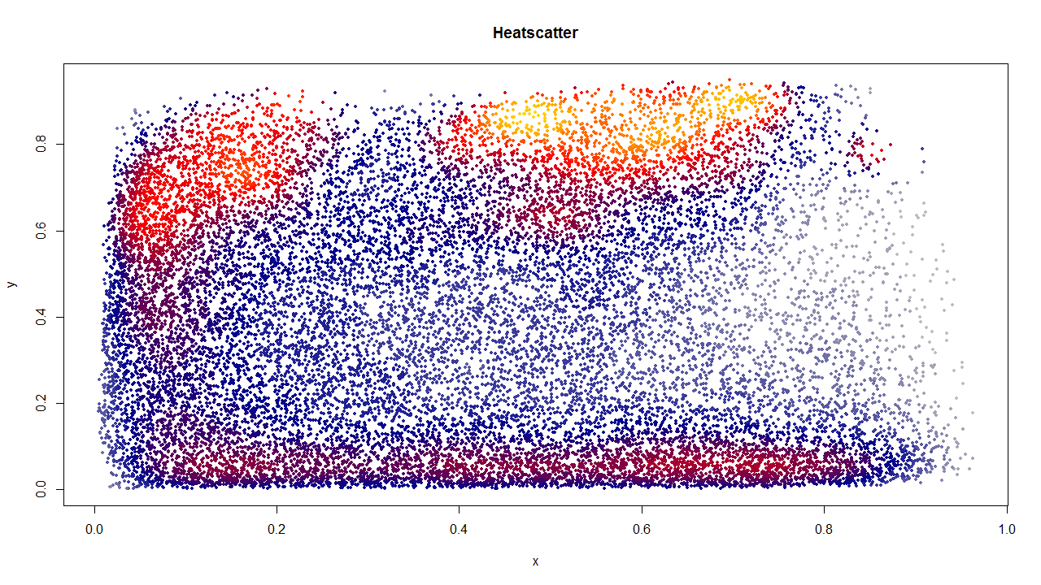
Grant Clustering

Slide 14
References
NIH
Hive
SNAP

